Slide 1
STUDENT NAME
KRISHNA PRIYA S
BE-CSE,3rd YEAR
SIR ISSAC NEWTON COLLAGE Of
ENGINEERINGAND TECNNOLOGY

Slide 2
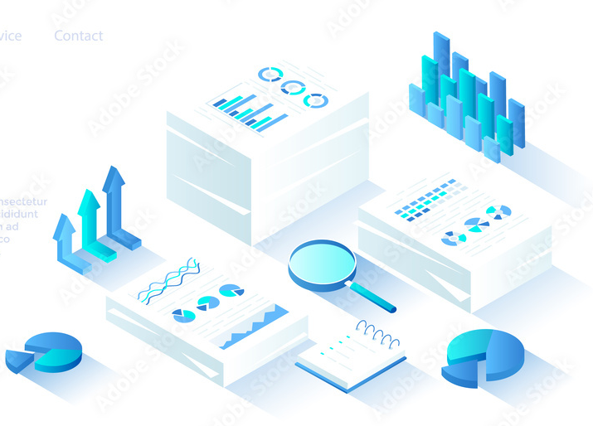
PROJECT TITTLE
DATA ANAIYSIS OF DOCUMENTS

Slide 3
AGENDA
Creating an agenda for data analysis of documents involves outlining the steps and methodologies you'll use to extract insights from the document
Objectives and Scope
Data Collection
Data Preprocessing
Exploratory Data Analysis
Documentation and Reporting
data analysis of documents and derive meaningful insights to support decision-making and strategic planning.

Slide 4
PROBLEM STATEMENT
The problem statement for data analysis of documents hold valuable insights and patterns that can significantly impact decision-making processes, strategic planning, and operational efficiency.
The problem lies in the complexity of processing and analyzing large volumes of documents efficiently. Traditional manual methods are time-consuming, error-prone, and often unable to handle the sheer scale of data. Moreover, as the volume of documents continues to grow exponentially, organizations face challenges in identifying relevant information, detecting trends, and extracting actionable insights.

Slide 5
PROJECT OVERVIEW
The Data Analysis of Documents project aims to leverage advanced data
analysis techniques to extract valuable insights and patterns from unstructured document
data. By implementing cutting-edge technologies such as natural language processing (NLP),
machine learning (ML), and text mining, the project seeks to enable organizations to unlock
the hidden potential within their document repositories.
Requirements Gathering and Planning
Design and Development of Document Processing Pipeline
Implementation of NLP and ML Models
Development of Visualization Tools and Reporting
Testing, Deployment, and Optimization
Training and Support for Stakeholders

Slide 6
WHO ARE THE END USERS
The end users for Data Analysis of Documents can vary depending on the specific context and the nature of the organization implementing the solution.
Business Analysts and Data Scientists: These professionals typically use document analysis to extract insights that inform strategic decision-making, market research, and competitive analysis.
Legal Professionals: Lawyers, legal analysts, and compliance officers may use document analysis to review contracts, identify risks, and ensure regulatory compliance.
Researchers and Academics: Researchers in fields such as social sciences, humanities, and market research often analyze documents to identify trends, patterns, and new insights.
Human Resources Professionals: HR professionals may analyze documents such as resumes, performance reviews, and employee surveys to identify talent, assess organizational culture, and improve employee satisfaction.

Slide 7
YOUR SOLUTION AND ITS VALUE PROPOSITION
As an AI language model, I can offer insights into how organizations can leverage solutions for data analysis of documents.
Solution:
Natural Language Processing (NLP): I utilize advanced NLP techniques to understand the content of documents. This involves tasks such as tokenization, part-of-speech tagging, named entity recognition, and sentiment analysis.
Text Summarization: I can condense lengthy documents into concise summaries, making it easier for users to grasp the main points quickly.
Information Extraction: I extract key information from documents, such as important dates, names, locations, and events, which can be useful for various analytical purposes.
Value Proposition:
Efficiency: My solution automates the data analysis process, saving time and resources compared to manual methods. It can process large volumes of documents quickly and consistently.
Accuracy: With advanced NLP techniques, my solution can accurately interpret the nuances of language, leading to more precise analysis results.

Slide 8
THE WOW IN YOUR SOLUTION
I'm glad to hear that you're impressed! Data analysis of documents can be quite impactful, especially when utilizing advanced techniques to extract valuable insights from large volumes of text.
Machine Learning Models: Utilizing machine learning models for tasks such as document classification, clustering, or regression can enable the system to automatically categorize and organize large volumes of documents.
Data Visualization: Creating visually appealing and informative visualizations (e.g., word clouds, heatmaps, network graphs) to represent patterns, trends, and relationships within the document data can make the analysis more intuitive and impactful.
Real-time Analysis: Implementing real-time document analysis capabilities, where new documents are processed and analyzed as they arrive, can be quite impressive, especially in applications requiring timely insights or decision-making.
Combining these elements in a coherent and user-friendly manner can indeed elicit a "wow" response from stakeholders, showcasing the power and potential of document data analysis.

Slide 9
MODELLING
Modeling for data analysis of documents typically involves using techniques like natural language processing (NLP) to extract insights from textual data.
Data Collection: Gather the documents you want to analyze. These could be text files, PDFs, web pages, etc.
Data Preprocessing: Clean the data by removing irrelevant information, formatting text, handling special characters, and standardizing the text format.
Tokenization: Break down the text into smaller units such as words, phrases, or sentences.
Feature Extraction: Convert the text into numerical or categorical features that can be used for modeling. This could involve techniques like TF-IDF (Term Frequency-Inverse Document Frequency), word embeddings (Word2Vec, GloVe), or one-hot encoding.
Model Selection: Choose the appropriate model for your task, such as classification, clustering, or regression. Common models for document analysis include:
Naive Bayes
Support Vector Machines (SVM)
Decision Trees

Slide 10
Model Training: Train the selected model on your preprocessed data.Split your data into
training and validation sets to evaluate the model's performance.
Model Evaluation: Assess the model's performance using appropriate evaluation metrics
such as accuracy, precision, recall, F1-score, or others depending on the specific task.
Hyperparameter Tuning: Fine-tune the model's hyperparameters to improve its performance.
Deployment: Once satisfied with the model's performance, deploy it to make predictions
on new documents.
Monitoring and Updating: Continuously monitor the model's performance and update
it as needed to maintain its accuracy and relevance over time.

Slide 11
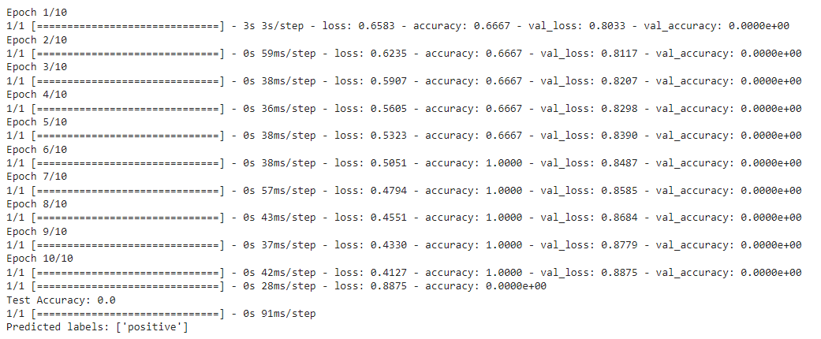
RESULT

Slide 12
THANK YOU

